Slide 1
Aim 3.2 - Regression Analysis
Outcome
Model
Data
A quantified prediction for a patient’s LOS at ICU compared to clinical average
Support Vector Machine
Nonlinear relationship
Linear Regression
Linear supervised learning
Intraoperative
Post-operative
Medication
Type (function)
Dosage
Pulmonary Artery (PA) Pressure
% increase from the patient’s own baseline level @T = 0
>= 25% increase => PA stiffness
Notes:
Xinyue
Logistic Regression: popular classification algorithm that can be used for supervised learning tasks. It works by modeling the probability of a binary outcome variable as a function of the input features.
Support Vector Machines: It works by finding a hyperplane that maximizes the margin between the predicted values and the actual values. SVM can handle nonlinear relationships and can be used with different kernel functions to model complex relationships.

Slide 2
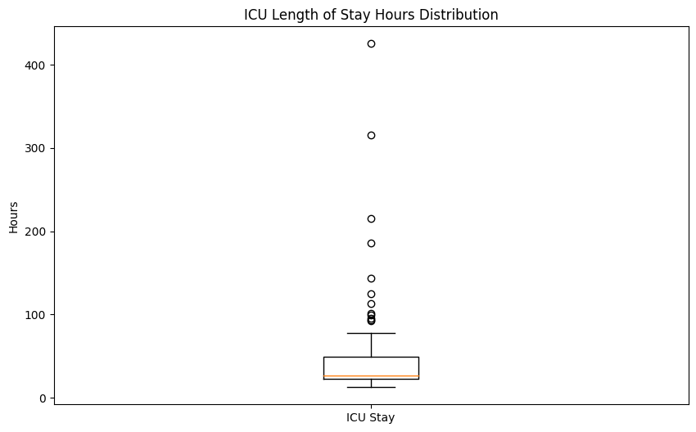
Regression Model Approach
Identify icu length of stay (hours) as target variable
Identify and remove outliers:
Original data size: 147
Filtered data size: 135
Train and Evaluate both SVR and Linear Regression models
Validate results using metrics: RMSE and R^2

Slide 3
Validation Results
SVM Results
LINEAR REGRESSION Results
Mean Absolute Error: 17.53
RMSE: 24.53
R-squared: -0.58
Mean Absolute Error: 19.83
RMSE: 24.66
R-squared: -0.60

Slide 4
Next Steps
Prioritize Feature selection (Use recursive feature elimination)
Time series data: PAS, PAD
Hyperparameter tuning (Grid Search) to improve performance
Explore Ensemble Methods similar to classification model.
Cross Validation for better performance estimates

